Slide 1
Logic(s) of thermal wind balance: Warm and cool core cyclones
ATM 651

Slide 2
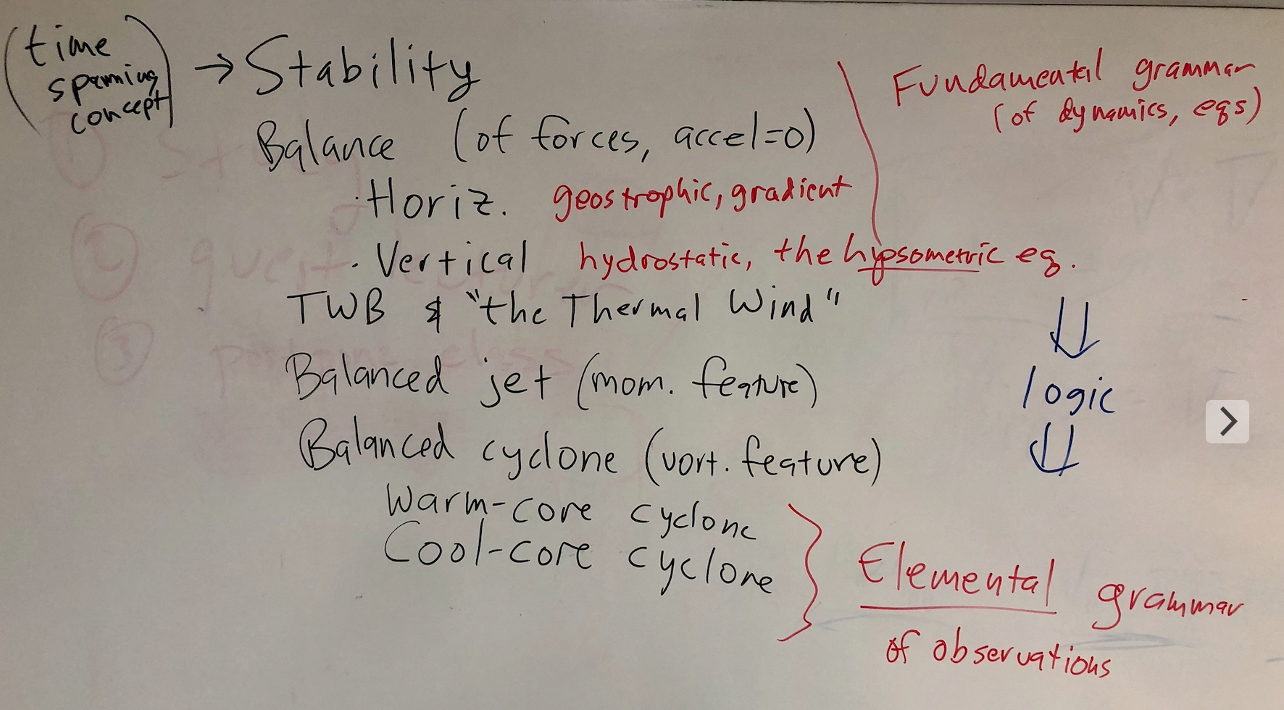
Balanced vortices: logically a long way from Fundamentals, but still Elemental (basic to the observed atmosphere)

Slide 3
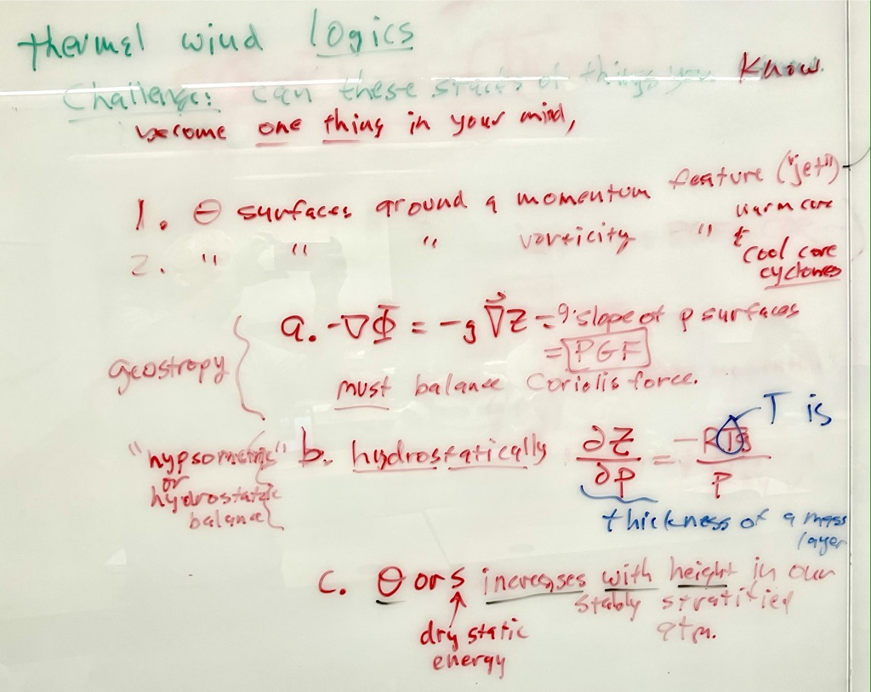

Slide 4
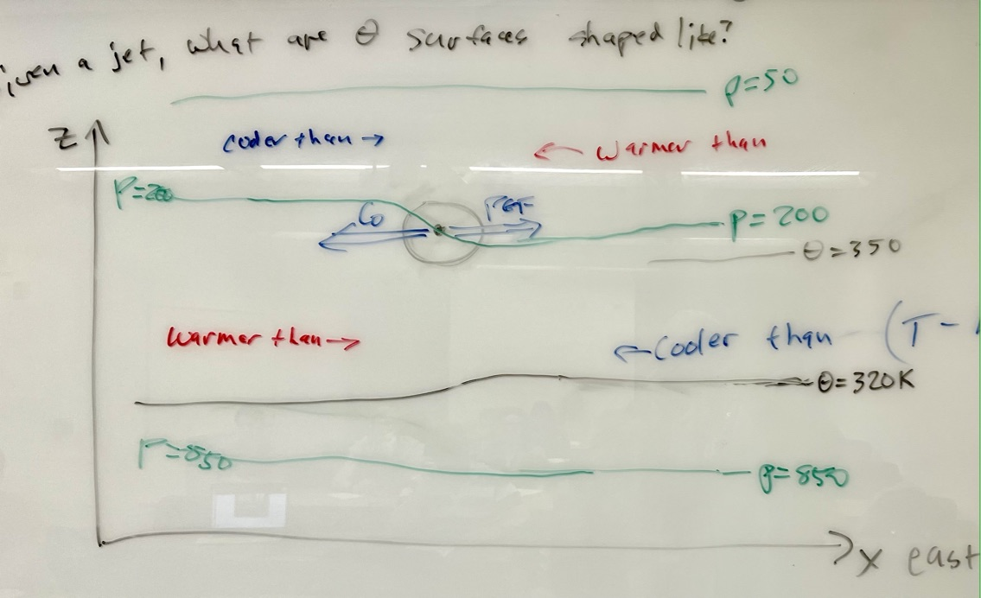

Slide 6
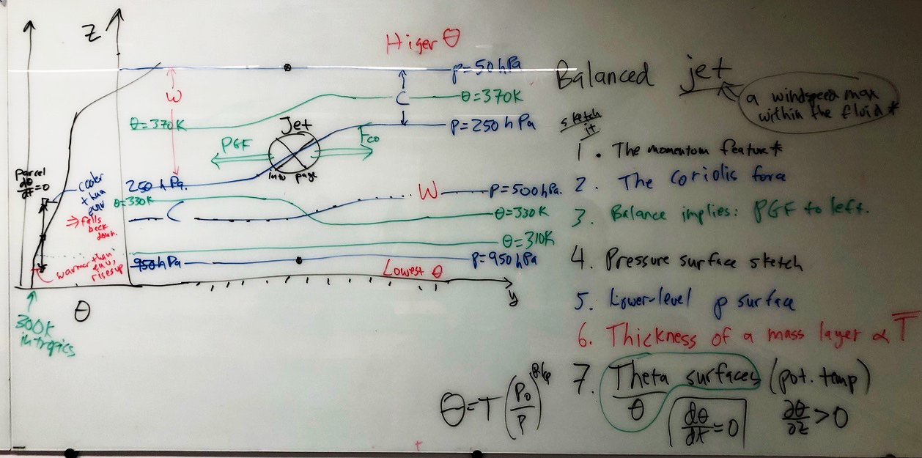
2021 Given: a Jet. Sketch p, θ surfaces.

Slide 7
p surfaces on a z-coordinate diagram
for NH westerly jet stream in thermal wind balance
→
z
150 mb
thinner mass (Δp) layers,
cooler compared to
← that
big thickness of mass (Δp)
layers: warm compared to that →
200 mb
300 mb
Jet stream
into page
PGF is “downhill”
Coriolis force to R
500 mb
small thickness of
mass (Δp) layers:
cooler, compared to that→
same mass (Δp) layers
are thicker: warmer than
← that
700 mb
1000 mb
North
South

Slide 8
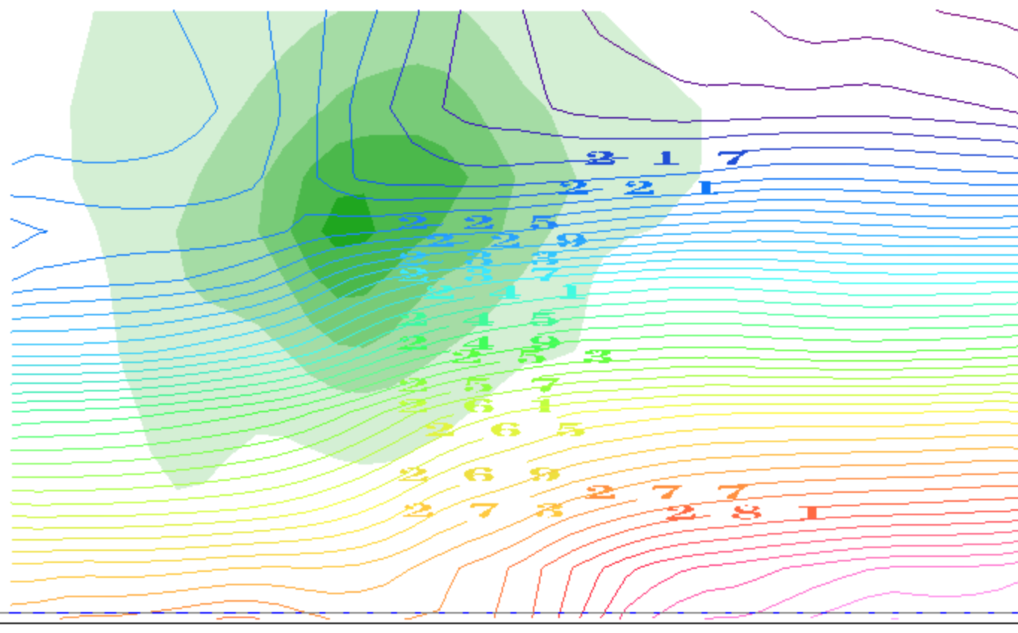
contours of T(K): it decreases with height
(plus the horizontal gradients due to TWB)
thinner mass (Δp) layers,
cooler compared to
← that
big thickness of mass (Δp)
layers: warm compared to that →
small thickness of
mass (Δp) layers:
cooler, compared to that→
same mass (Δp) layers
are thicker: warmer than
← that
North
South

Slide 9
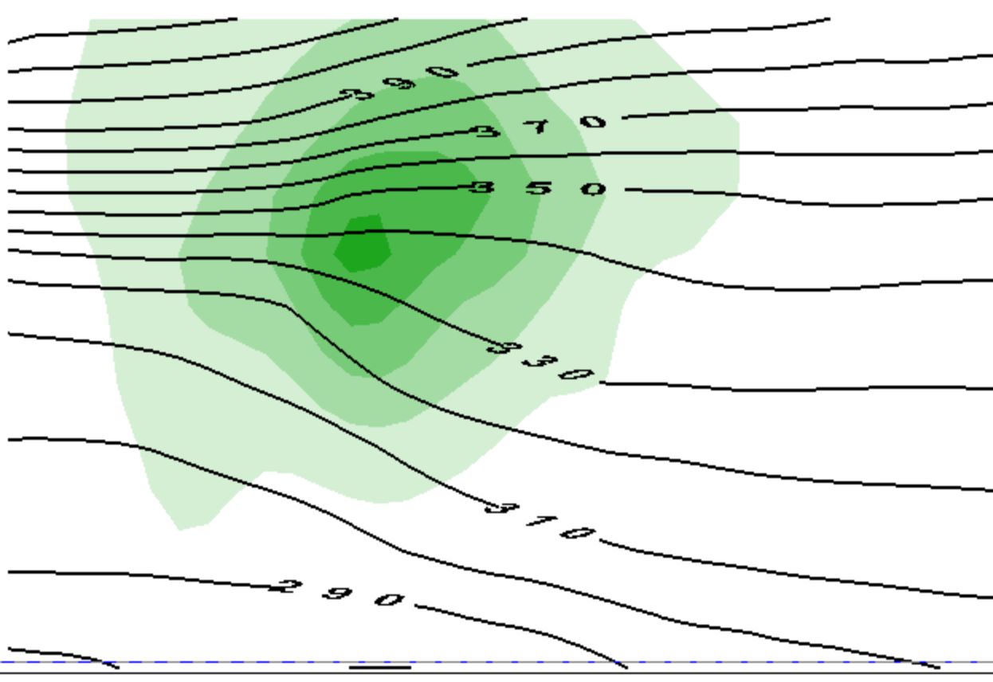
contours of θ(Κ): it increases with height
(plus the horizontal gradients due to TWB)
thinner mass (Δp) layers,
cooler compared to
← that
big thickness of mass (Δp)
layers: warm compared to that →
small thickness of
mass (Δp) layers:
cooler, compared to that→
same mass (Δp) layers
are thicker: warmer than
← that
North
South

Slide 10
This is only half the story of a vortex
cooler than
← that
warmer than
that →
cooler than
that→
warmer than
← that

Slide 11
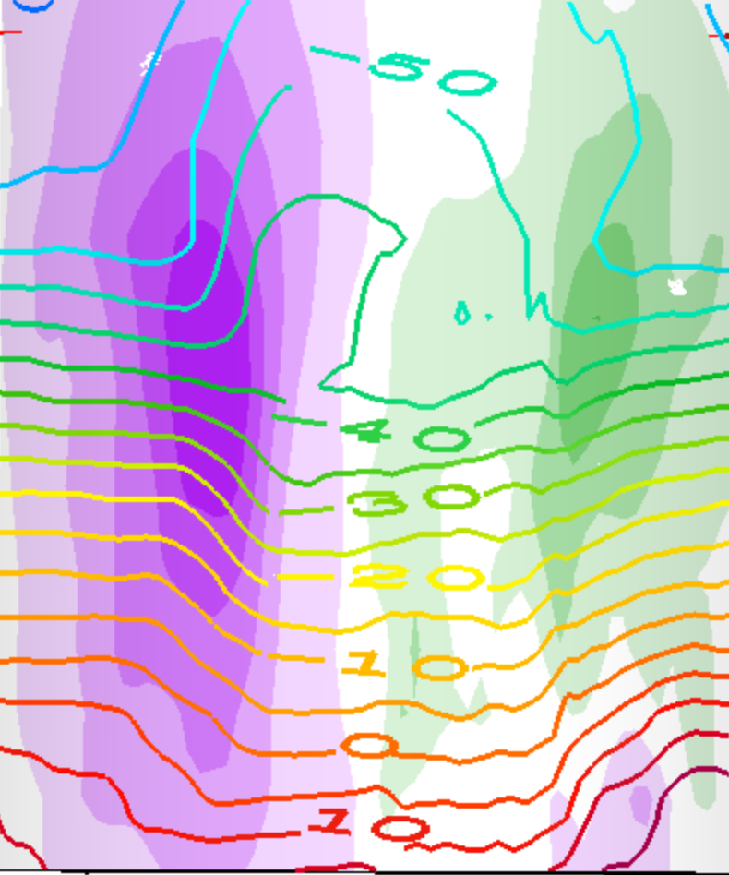
This is a whole vortex (two jets)
T(K) contours
cooler than
that →
warmer than
← that
cooler than
← that
warmer than
that →
warmer than
that →
cooler than
← that
cooler than
that→
warmer than
← that

Slide 12
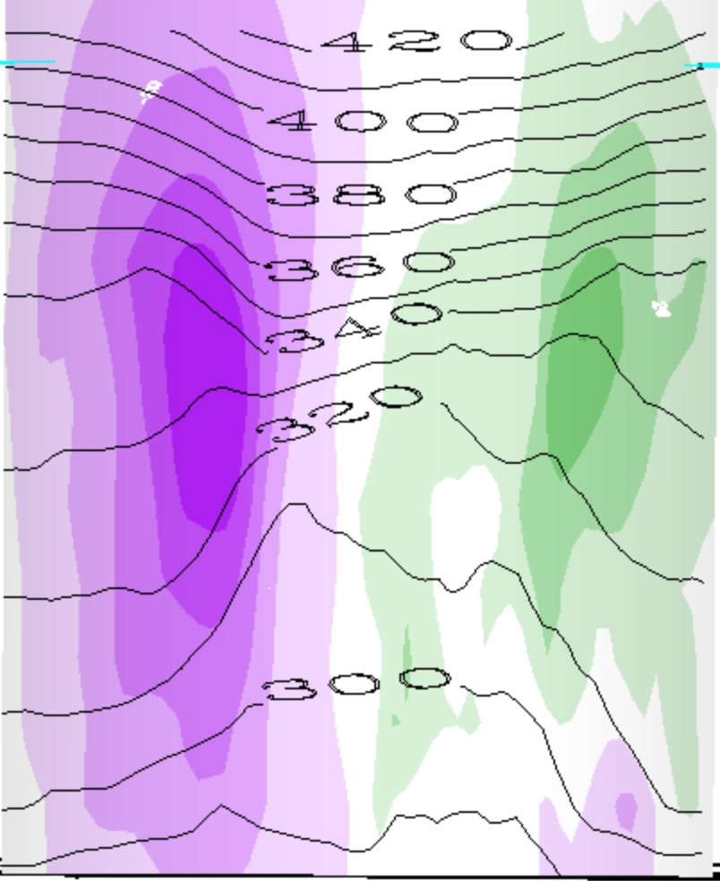
This is a whole vortex (two jets)
θ(K) contours
warmer than
← that →
above the cyclone
cooler than
← that →
below the cyclone

Slide 13
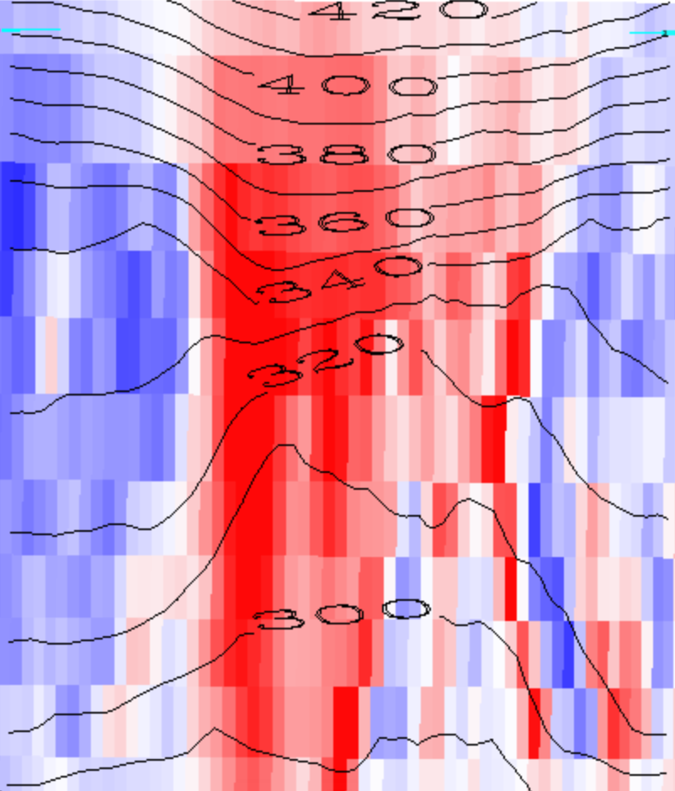
Red is positive vorticity , θ(K) contours
warmer than
← that →
above the cyclone
cooler than
← that →
below the cyclone

Slide 14
Red is positive vorticity , θ(K) contours
warmer than
← that →
above the cyclone
Cyclonic Vortex
cooler than
← that →
below the cyclone

Slide 15
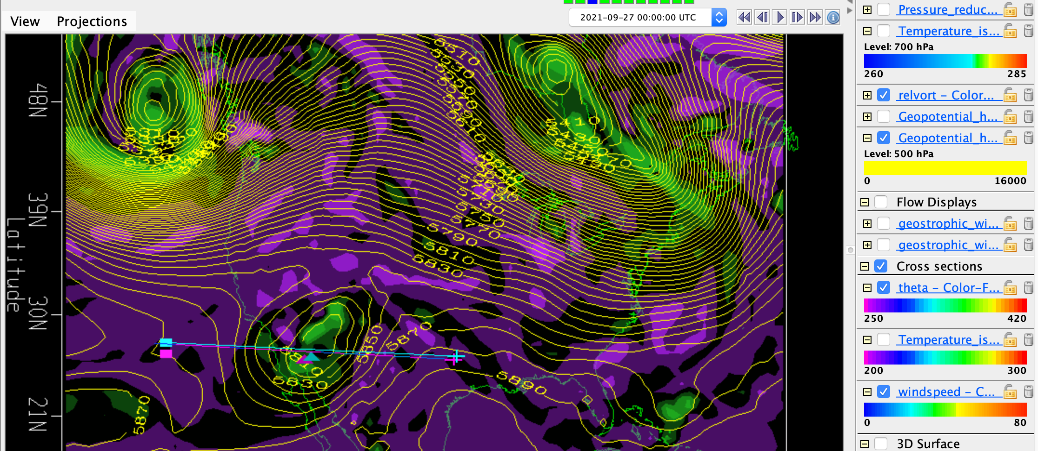
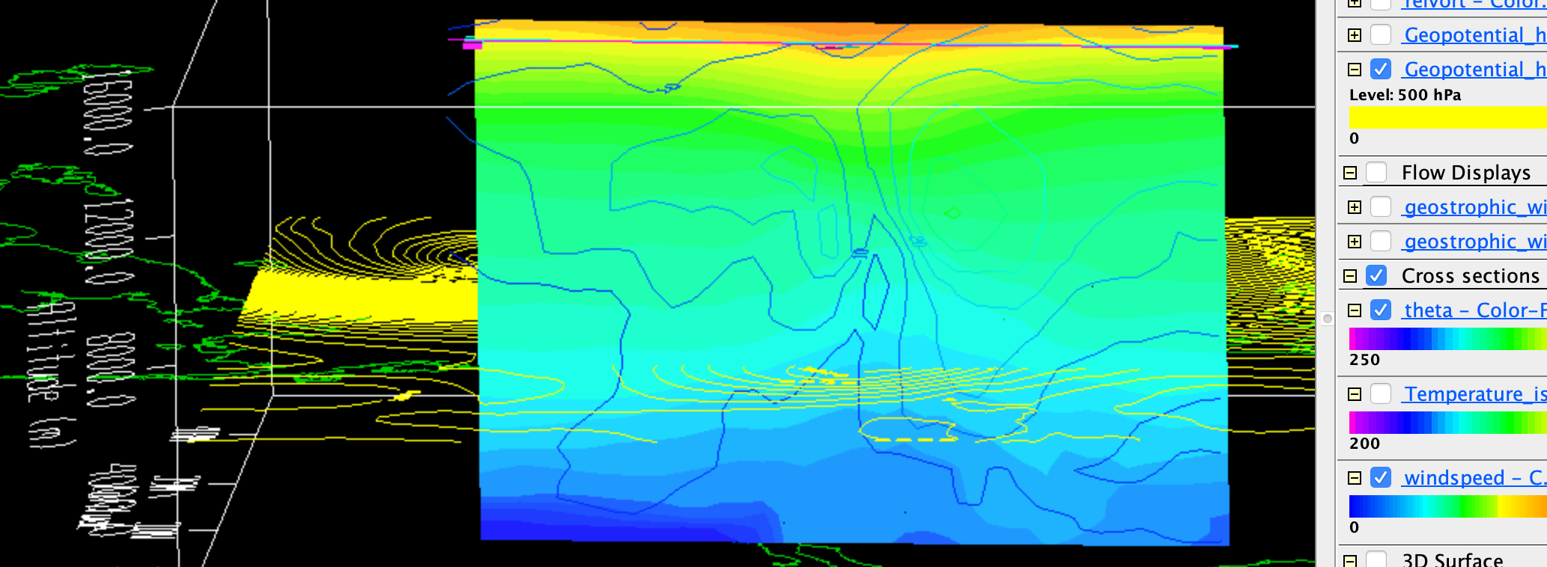
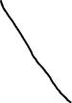
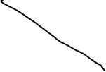

Slide 16
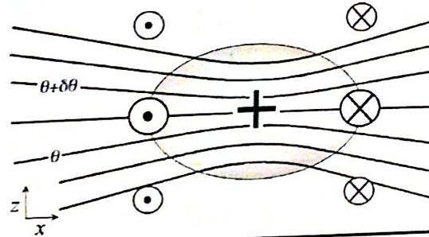
Generalization: PV
1. We will see that every cyclonic vortex obeying vertical (hydrostatic) and horizontal (geostrophic or other) balance looks similar to this (maybe stretched or shrunk):
PV > 0

Slide 17
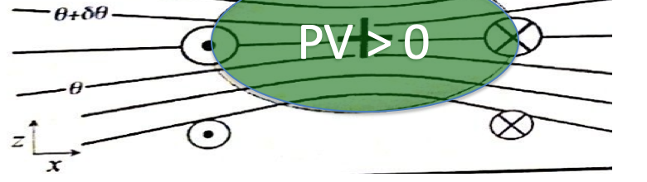
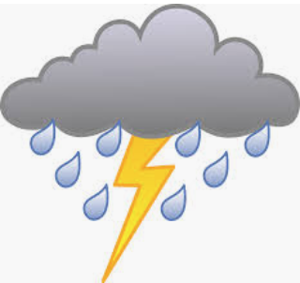
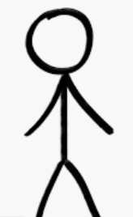
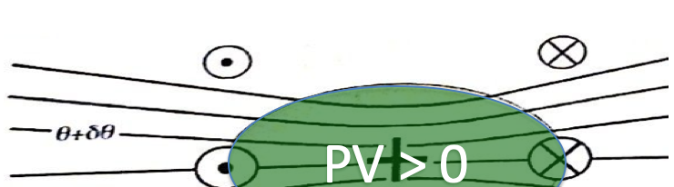
Since our main weather concern is in the lower troposphere (where water is),
This is called a cool core cyclone:
This is called a warm core cyclone:

Slide 18
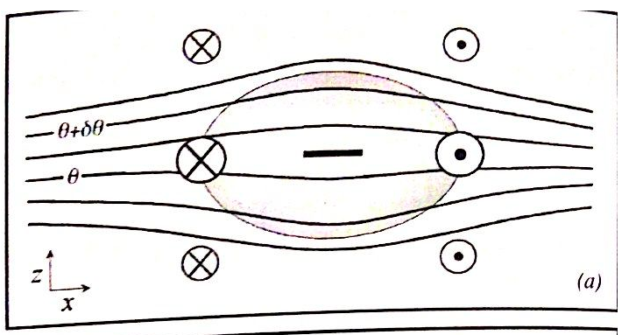
Balanced anticyclones exist too...
Just the opposite of a cyclone...
PV < 0

Slide 19
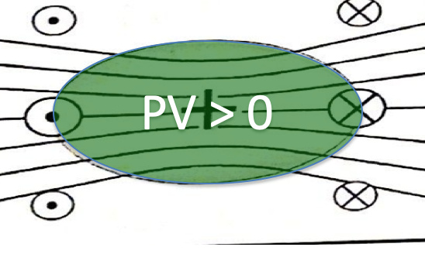
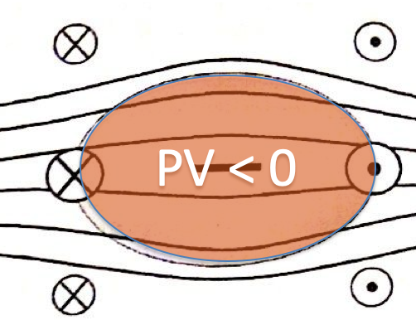
Vorticity (or PV) blobs
Where do they come from?
How do they interact?
(this we studied, in the horizontal plane)
Do they get destroyed?
(Soon: tackling the complications)

Slide 20
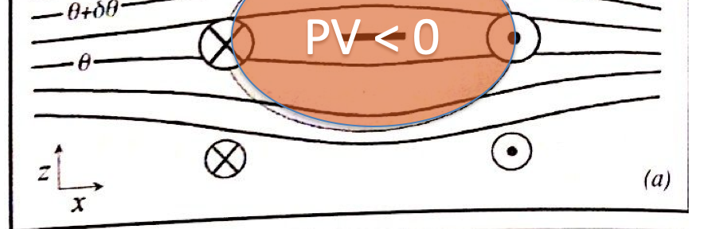
A warm core anticyclone
Where? Describe the situation.

Slide 21
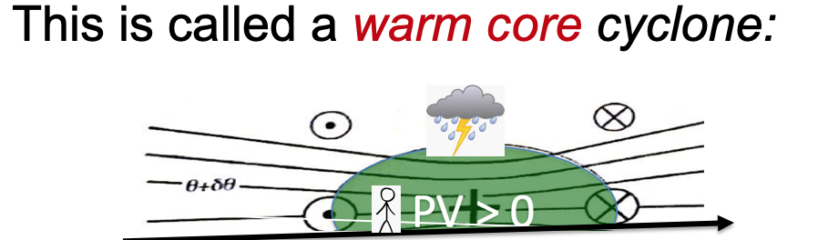
A warm core cyclone
Where? Describe the situation

Slide 22
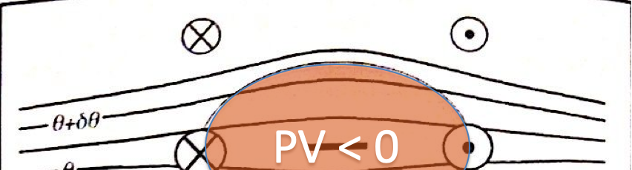
A cool core anticyclone
Where? Describe the situation

Slide 23
Question: what the heck is absolute vorticity
How is it conserved, in other words
planetary plus relative
how is f “planetary vorticity”? Last I heard it was the strength of the Coriolis force (when multiplied by velocity)

Slide 24
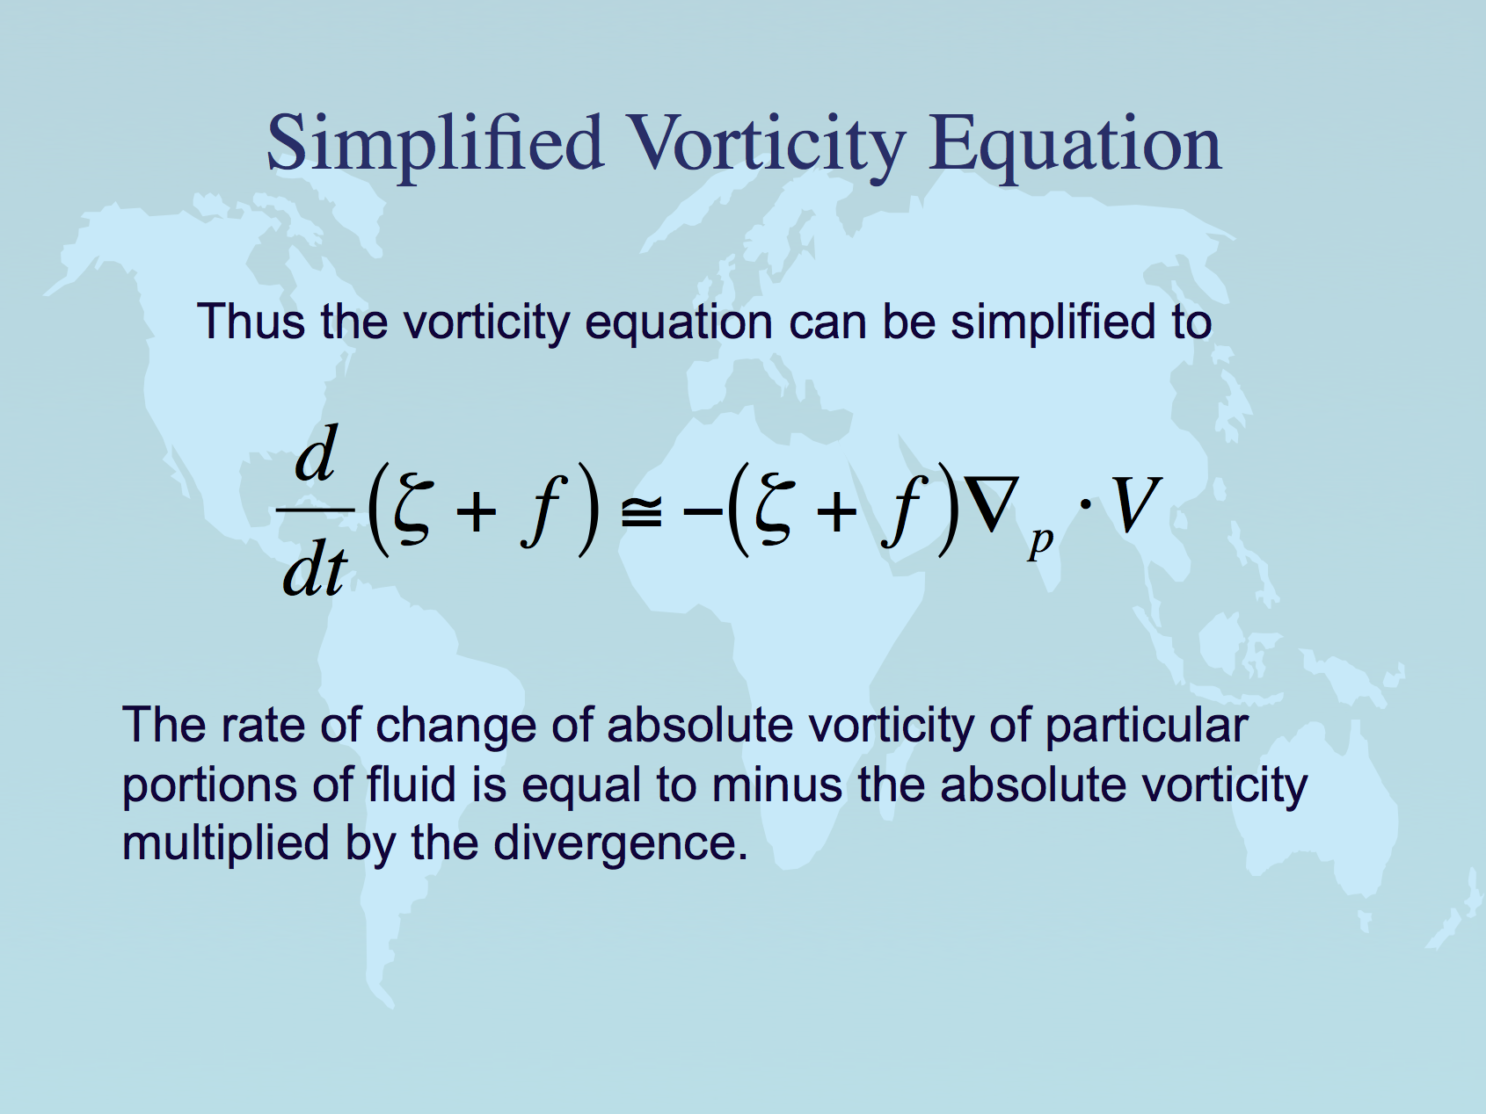
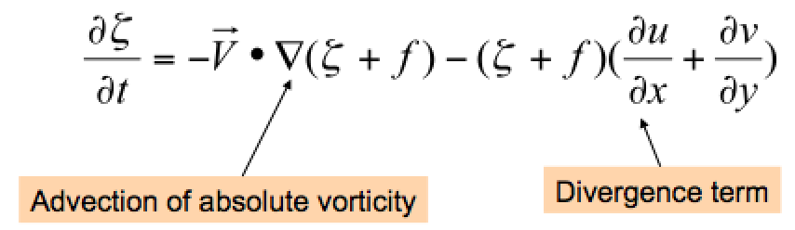
Same equation in Eulerian (local rate of change with time) form.
Lackmann Eq. 1.51

Slide 25
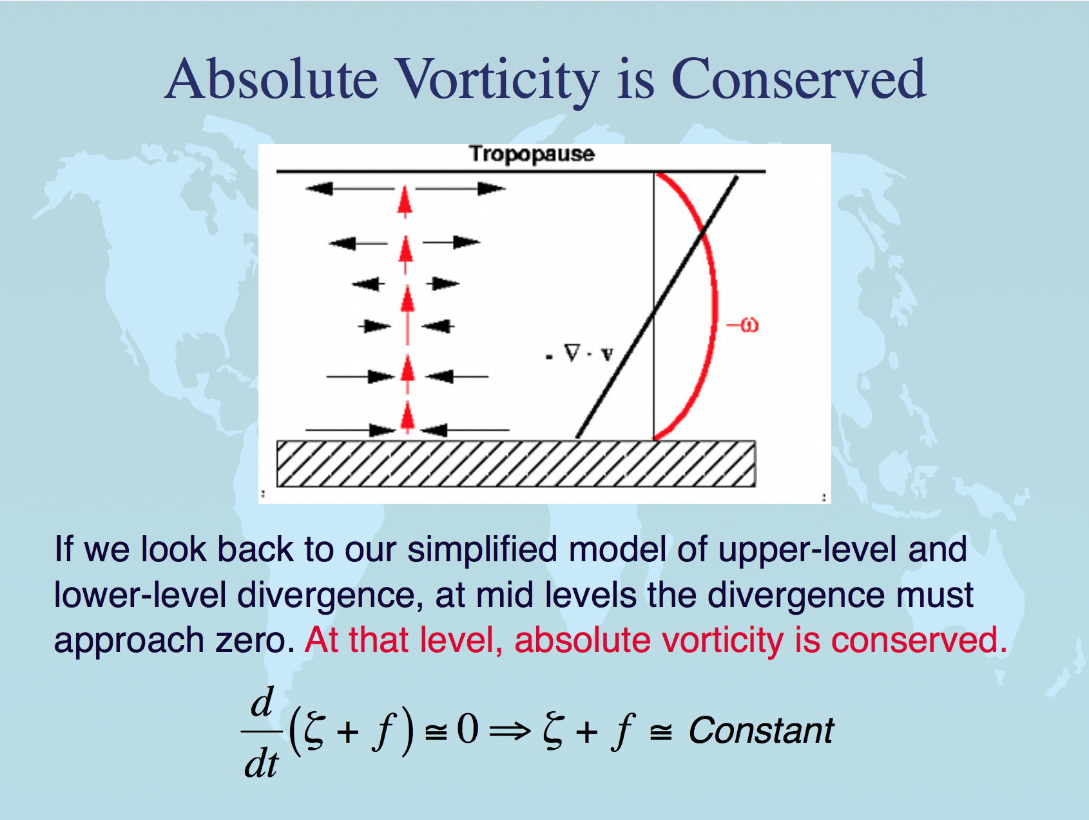
almost,
at midlevels
especially

Slide 26
Conservation of absolute vorticity: how?
When air moves north or south, it tends to conserve its absolute vorticity -- or in other words it converts planetary to relative vorticity. How?
Consider equatorward motion of a disc of fluid.
The initially high f = ζ_{plan} is converted to ζ_{rel}. How?
Physically, the Coriolis force fv is a little bit stronger on its poleward edge (where f is bigger) than on its equatorward edge. This imparts a cyclonic torque on the disk of fluid as it moves southward.
fv
v
All v winds the same, as the disk
moves southward as a unit →
(an eastward PGF must balance the mean Coriolis force, to keep the air flowing southward)
v
fv
v
v
Notes:
\frac {D\zeta_{abs}} {Dt} \simeq 0
\frac {\partial \zeta_{abs}} {\partial t} \simeq -\vec V \cdot \vec \nabla_p \zeta_{abs} - \omega \frac {\partial \zeta_{abs}} {\partial p}

Slide 27
Vorticity equation derivation
Take a breath. Organize terms (or differentiate in the smartest order in the first place).
Don’t panic

Slide 28
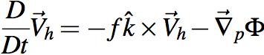
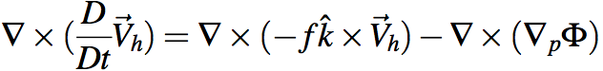
Holy grail of dynamics: get div & ω
Gotta avoid dragging thermo into this via Φ.
Get rid of Φ at any cost. Curl to the rescue!
Ker-CHING!
We are Masters of the Universe with our sexy vector identities!
The grail is in the bag!
Notes:
\nabla \times (\frac{D}{Dt} \vec V_h) = \nabla \times (-f \hat k \times \vec V_h) - \nabla \times (\nabla_p \Phi)

Slide 29
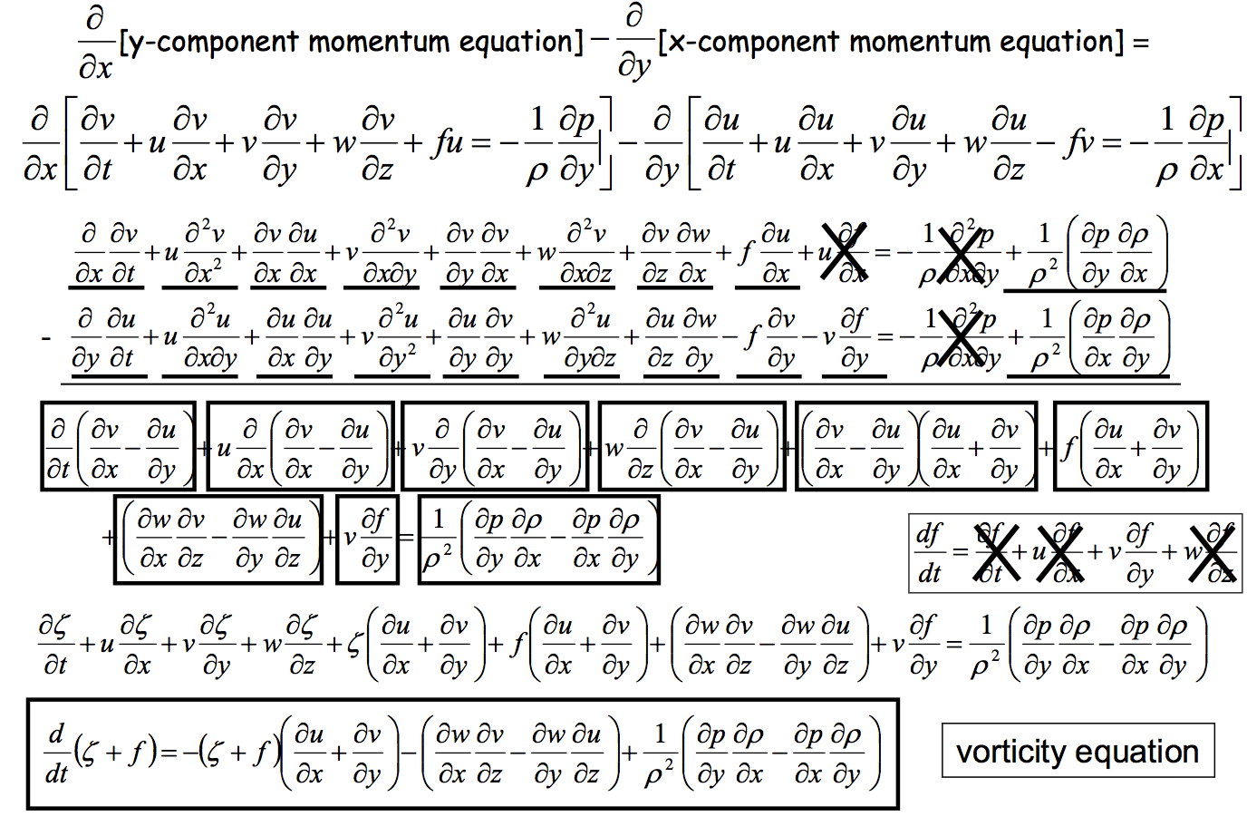
Heh heh ... did I say "any cost"... ? gulp
Can we scrape back some of these cobwebs?
Wait a sec, what's this??

